Slide 1
Stereo R-CNN based 3D Object Detection for Autonomous Driving
Yashaswi Ranga Sivaraju
Jay Bhanushali
Ketan Genmal Choudhary
Swathi Bhargavi Vadithe
Darshan Jayaram
Team-28

Slide 2
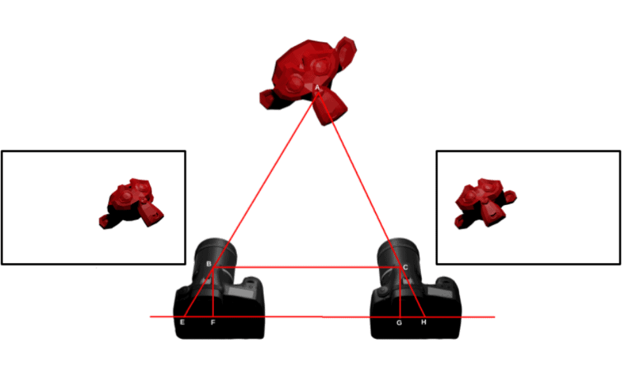
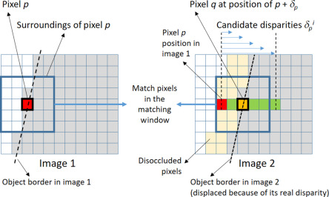
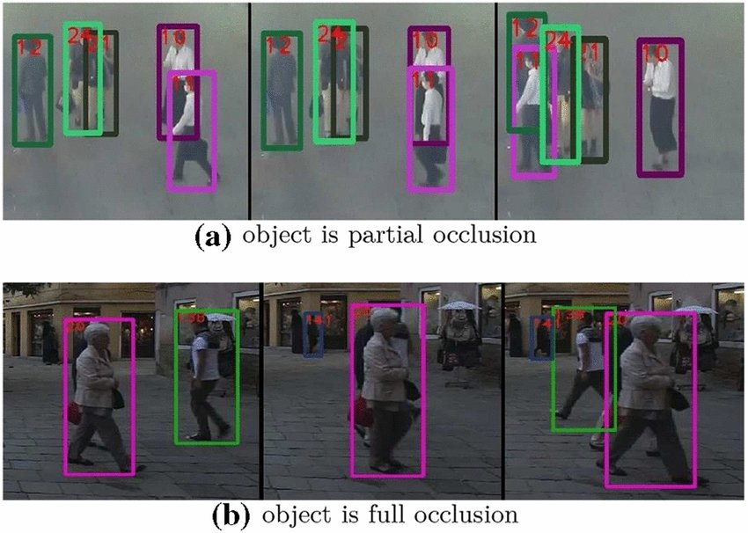
Problem Statement:
Disparity in images:
Occlusions:

Slide 3
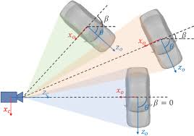
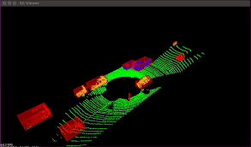
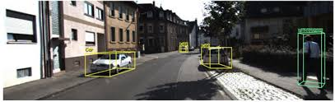
Related works
Here is a brief overview of recent works on 3D object detection:
1) LiDAR-based 3D Object Detection:
It is one of the fundamental aspects of autonomous systems. This uses LiDAR sensors to accurately recognize the environment in three dimensions. In recent years, many methods have emerged that uses LiDAR's capability to provide precise 3D information. These methods typically process raw LiDAR data in various representations to enhance detection accuracy.
2) Monocular-based 3D Object Detection:
Monocular-based 3D object detection refers to the process of detecting and localizing three-dimensional objects in the environment using only a single camera image. While monocular methods lack direct depth information, they rely on various cues and assumptions to infer the 3D structure of objects
3) Stereo-based 3D object detection:
Stereo-based 3D object detection leverages the information obtained from stereo vision, where depth is inferred by comparing the disparities between corresponding points in stereo image pairs.
Despite its potential, there are relatively few works in this area compared to LiDAR-based or monocular-based methods.

Slide 4
Background:
Performance: Tested on the KITTI dataset, the method improved 3D detection accuracy by 30%.
Next Steps: Focus on enhancing accuracy in more complex driving environments to further refine and extend the technology's application.

Slide 5
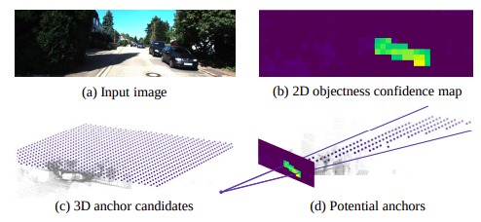
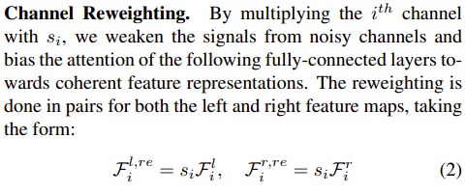
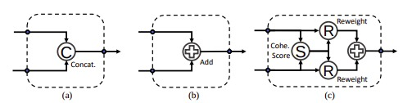
Methodology:
Key Enhancements:
Depth-Aware Weighting: Adjusts loss importance based on object depth to better focus on distant objects.
Uncertainty-Aware Loss Function: Dynamically weights loss components based on task uncertainty to improve learning focus and accuracy.
Keypoint Localization Improvement: Adds a loss component for precise keypoint detection to enhance 3D bounding box accuracy.

Slide 6
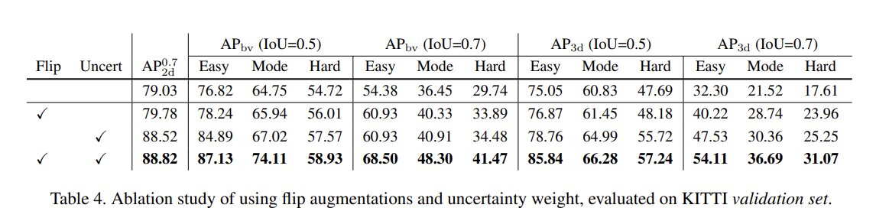
Strategies used:
1. Flip Augmentation ​
With stereo flip augmentation, the left-right images are flipped and exchanged, and​
the training target for the perspective key point and viewpoint are also adjusted respectively.
Uncertainty weighting​
Balancing the multi-task loss using uncertainty weight yields non-trivial improvements in both 3D​
detection and localization tasks.
Conclusion and Future work:​
Stereo R-CNN can be extended for multiple object detection and tracking.​
We also aim to improve precision of our model by incorporating instance segmentation and learning object​ shapes.​

Slide 7
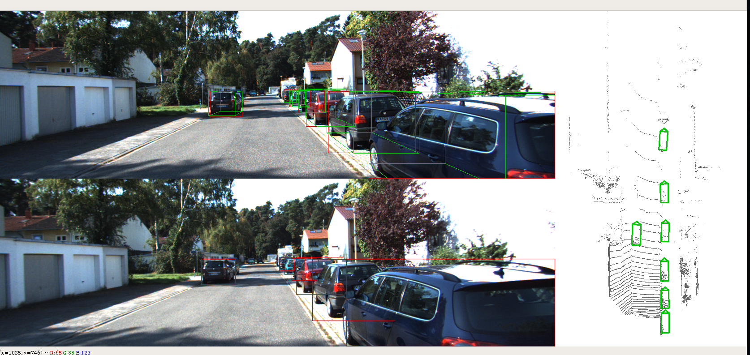
Stereo-RCNN Results:

